Slide 1
Kubernetes

Slide 2
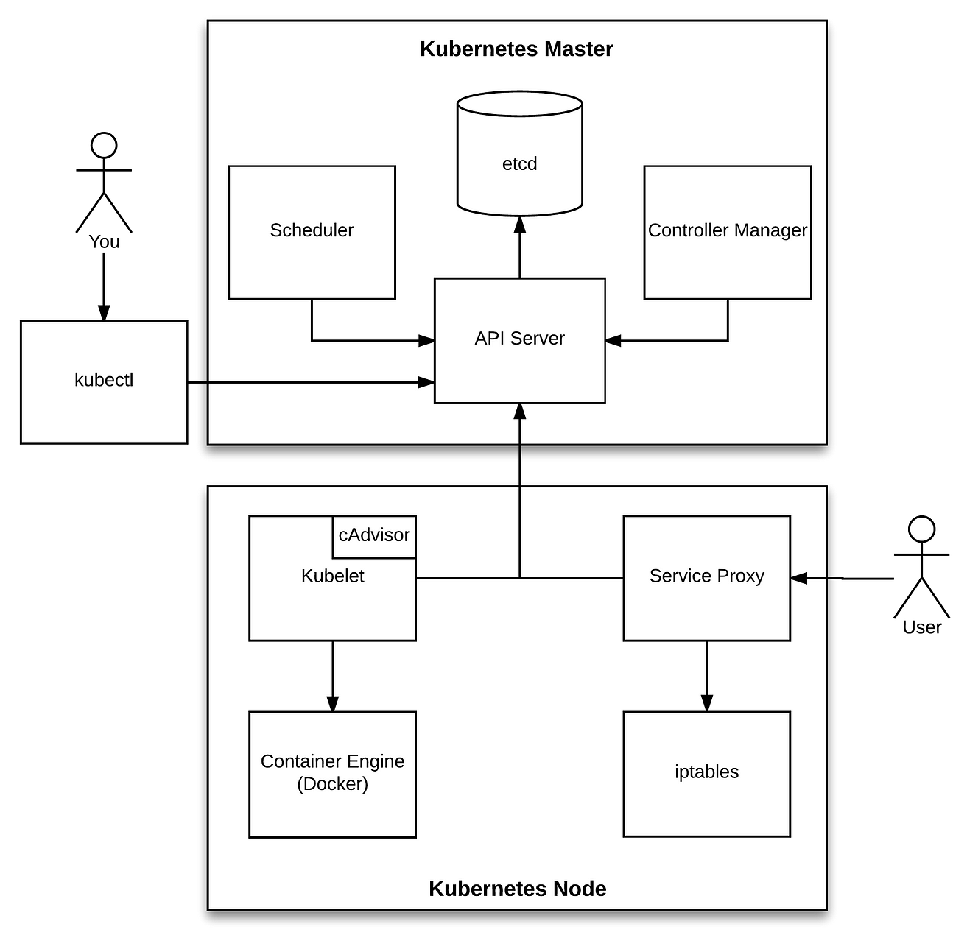
Architecture

Slide 3
API Server
When you interact with your Kubernetes cluster using the kubectl command-line interface, you are actually communicating with the master API Server component.
The API Server is the only Kubernetes component that connects to etcd; all the other components must go through the API Server to work with the cluster state.
Etcd
Etcd is a distributed, consistent key-value store used for configuration management, service discovery, and coordinating distributed work.
When it comes to Kubernetes, etcd reliably stores the configuration data of the Kubernetes cluster, representing the state of the cluster (what nodes exist in the cluster, what pods should be running, which nodes they are running on, and a whole lot more) at any given point of time.

Slide 4
Controller
Basically, a controller watches the state of the cluster through the API Server watch feature and, when it gets notified, it makes the necessary changes attempting to move the current state towards the desired state.
Scheduler
The Scheduler watches for unscheduled pods and binds them to nodes via the /binding pod subresource API, according to the availability of the requested resources, quality of service requirements, affinity and anti-affinity specifications, and other constraints. Once the pod has a node assigned, the regular behavior of the Kubelet is triggered and the pod and its containers are created.
Kube-Proxy
Kube-Proxy is a network proxy that runs on each node in a Kubernetes cluster. It is responsible for maintaining network connectivity between services and pods. Kube-Proxy does this by translating service definitions into actionable networking rules.

Slide 5
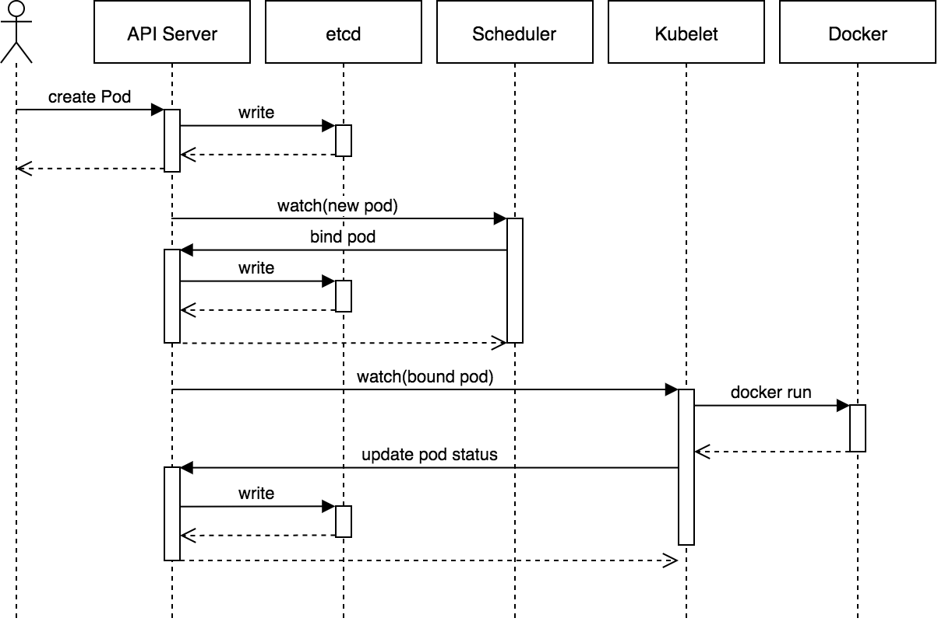
This pattern is extensively used in Kubernetes. For example, when you create a pod using kubectl, this what happens:

Slide 6
Process step by step
kubectl writes to the API Server.
API Server validates the request and persists it to etcd.
etcd notifies back the API Server.
API Server invokes the Scheduler.
Scheduler decides where to run the pod on and return that to the API Server.
API Server persists it to etcd.
etcd notifies back the API Server.
API Server invokes the Kubelet in the corresponding node.
Kubelet talks to the Docker daemon using the API over the Docker socket to create the container.
Kubelet updates the pod status to the API Server.
API Server persists the new state in etcd.
Api server persist the controller

Slide 7
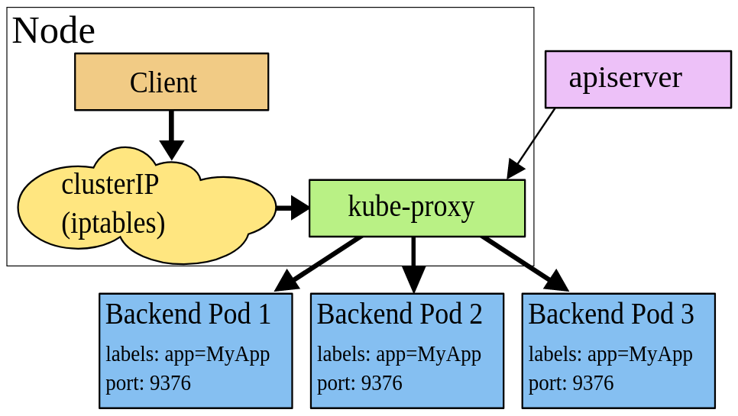
Kubeproxy
the rouning rules between pods between a Service and its Pods are controlled by the kube-proxy service that can be working in one of the three following modes – user space proxy mode, iptables proxy mode, and IPVS proxy mode.
Iptables proxy mode
Our case, which we will investigate in this post. Currently, is the default one.
When using this mode, kube-proxy watch for changes in a cluster and for each new Service will open a TCP port on a WorkerNode.
Then, iptables on this WorkerNode sends traffic from this port to a Kubernetes Service which is actually a chain in the iptablesrules, and via this chain, traffic goes directly to pods which are a backend for this Service. During this, a targeting pod is selected randomly.

Slide 8
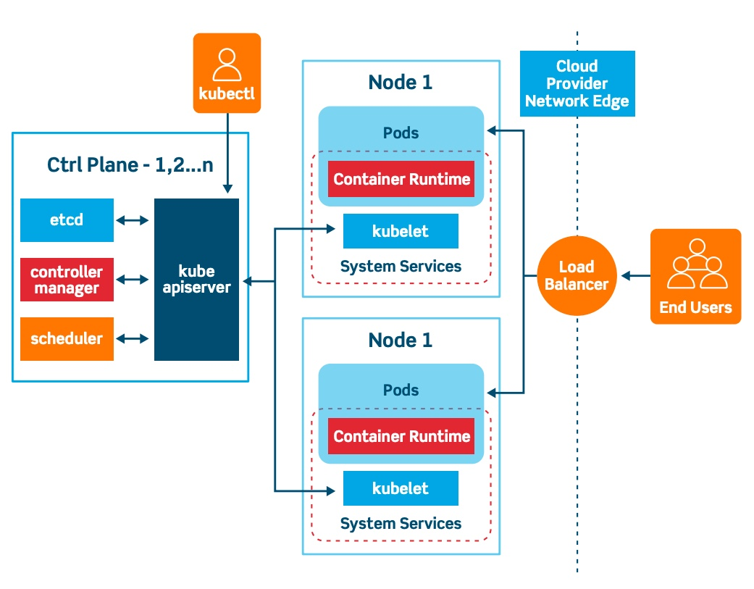
Architecture

Slide 9
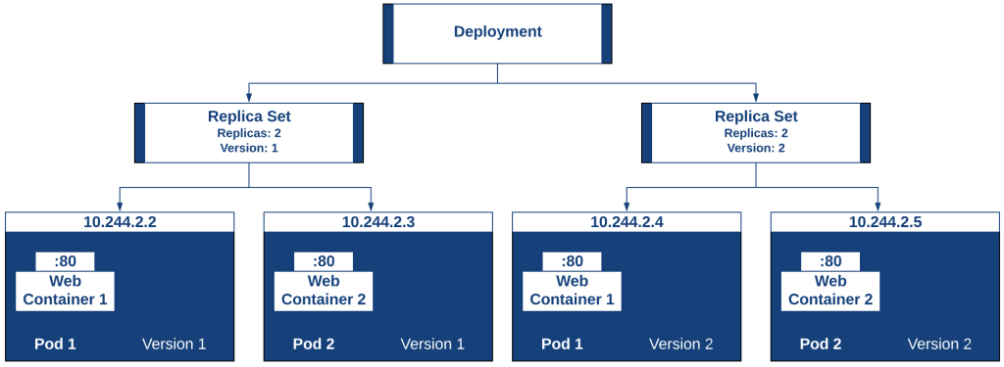
Deployment vs Replicaset vs Pod

Slide 10
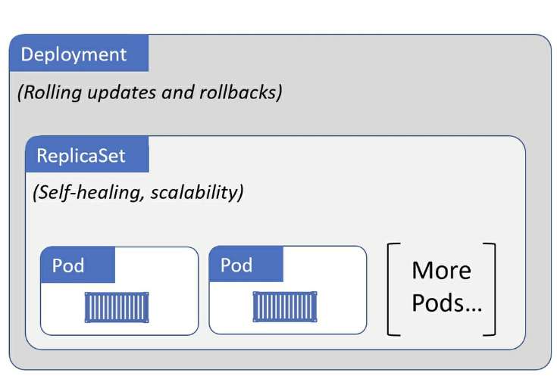

Slide 11
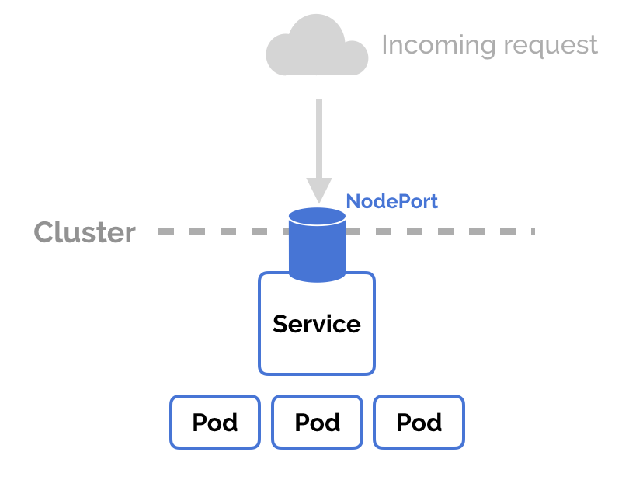
Node Port

Slide 12
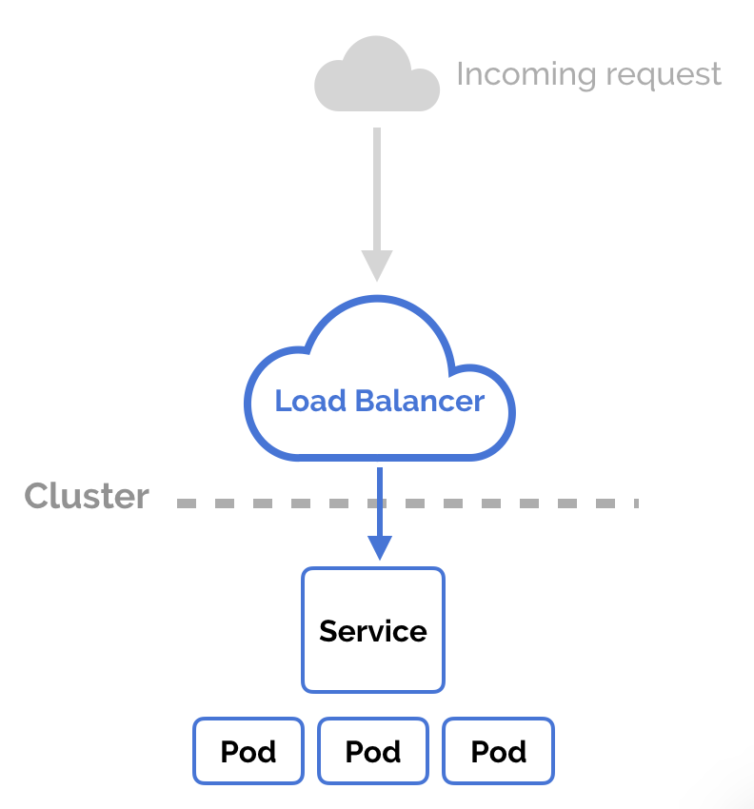
LoadBalancer

Slide 13
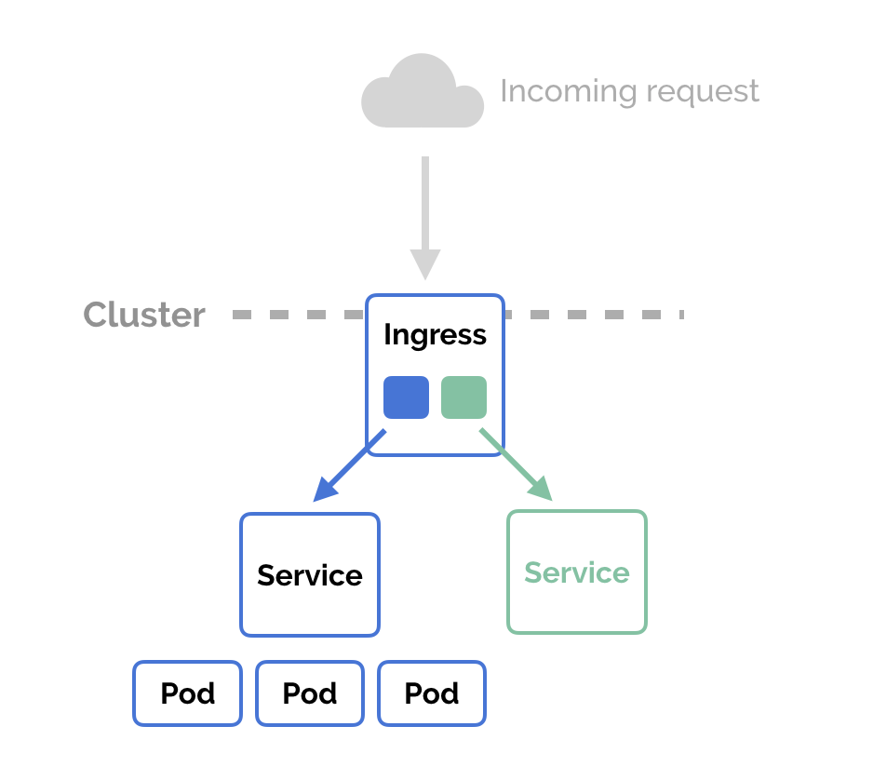
Ingress

Slide 14
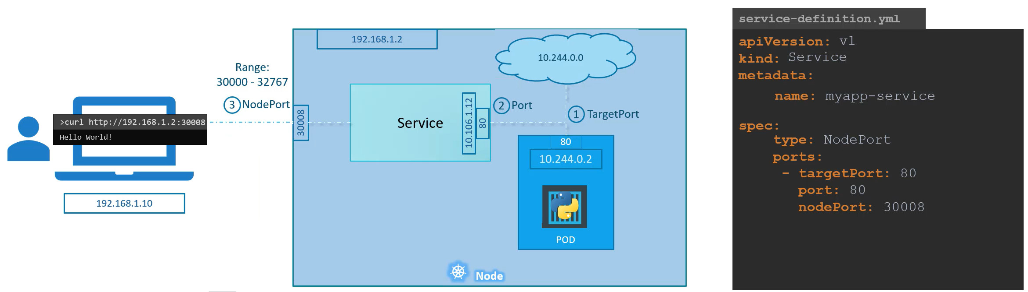
SERVICE

Slide 15
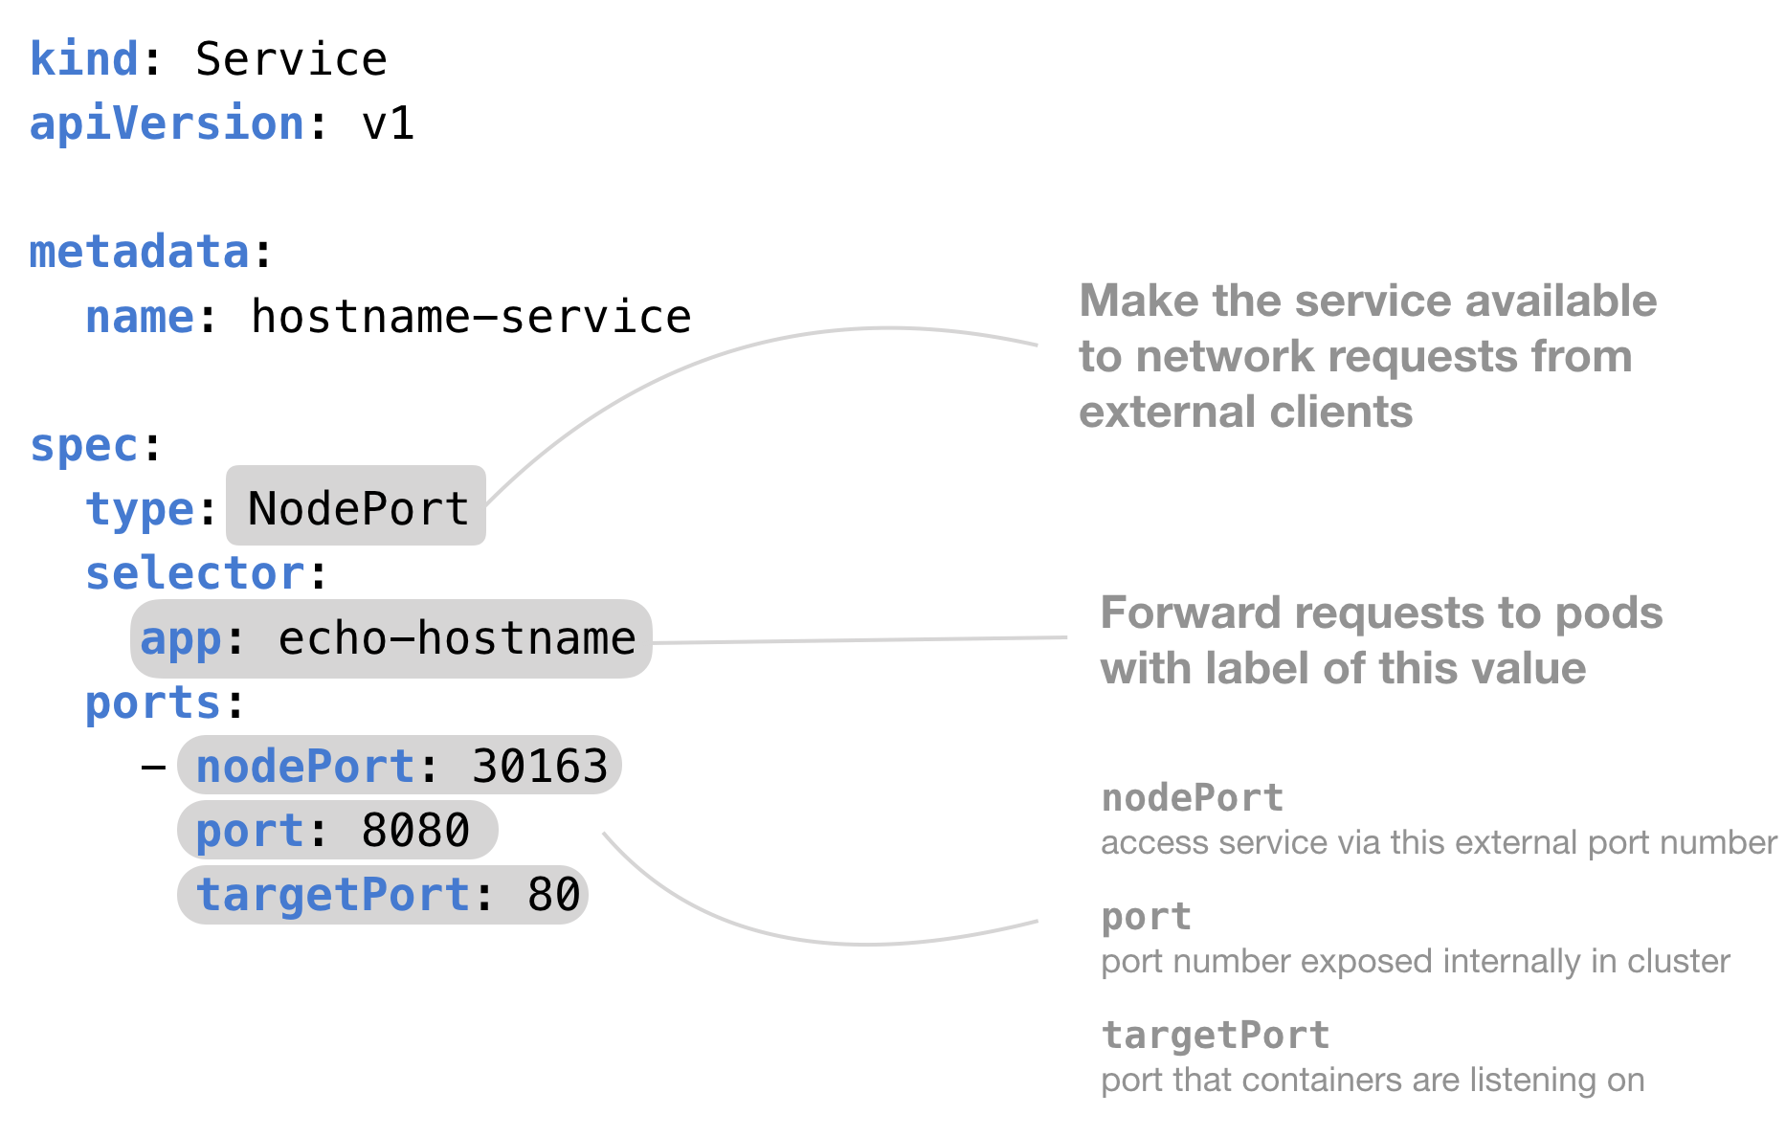

Slide 16
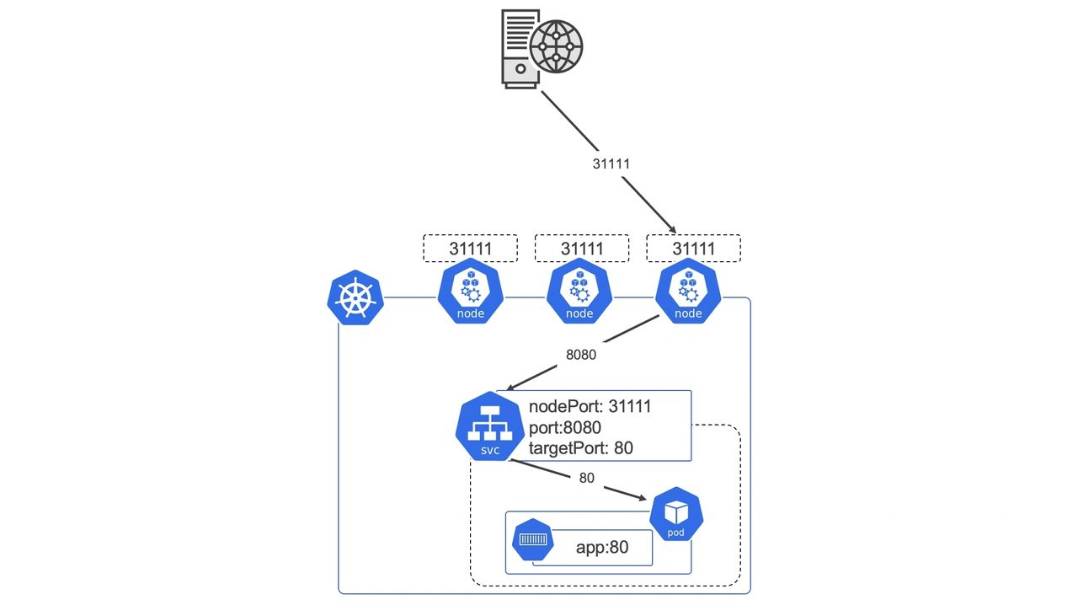
Service

Slide 17
